Slide 1

Everything is a Construction: New Goals for Syntactic and Semantic Probing
Joint work with Taiqi He, Naoki Otani, David Mortensen, Lori Levin and Hinrich Schütze
Leonie Weissweiler
01.03.2023

Slide 2
Outline
Why Construction Grammar?
Construction Grammar
Probing for the English Comparative Correlative
Probing for so-that sentences
Future Work

Slide 3
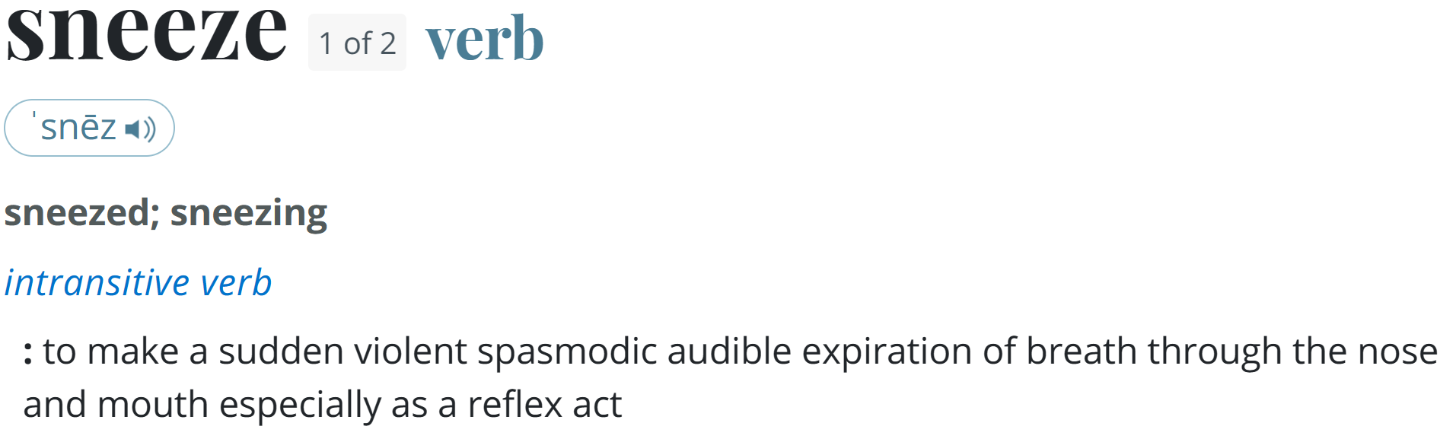
‚She sneezed the foam off her cappuccino.‘

Slide 4


Let‘s ask DeepL and Google Translate!
❌Sie nieste den Schaum von ihrem Cappuccino.
❌Ze niesde het schuim van haar cappuccino.
❌Elle a éternué la mousse de son cappuccino.
❌Estornudó la espuma de su capuchino.

Slide 5




Let‘s ask DALL-E!

Slide 6
Construction Grammar

Slide 7
It matters which theory of Syntax we use in NLP
Overgeneralisation: Universal Dependencies → Dependency Grammar → Syntax
Assessment of progress of the field: „Have Language Models acquired Syntax?“
Making recommendations from the Linguistics niche to the broader community:
‚Are we climbing the wrong hill?‘
‚Are language models learning language the right way?‘
‚Are language models learning the same way that humans do?‘

Slide 8
Let‘s look at which theories NLP has been using so far
Historically: Chomskian Grammar
Lexicon vs. Grammar
Competence vs. performance
„colourless green ideas sleep furiously“ → autonomy of syntax
Tree structure of sentences
Deep structure vs. Surface structure
Current Syntactic Paradigm: Dependency Grammar
Directed links between words form a tree structure
Compromises in UD for crosslinguistic comparability
Basic assumption: syntactic structure is rigid and semantic and frequency phenomena happen ‚on top‘ of it

Slide 9
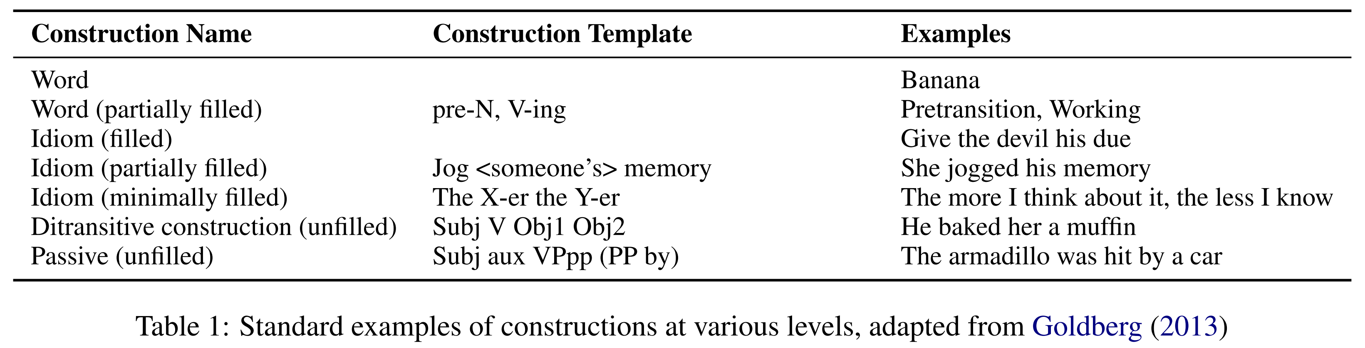
How is Construction Grammar different?
No strong line between lexicon and Syntax → Patterns (called Constructions) are stored in the brain the same way words are
Focus on surface form: no deep structure, no underlying transformations
Basic unit of analysis: pairing of form and meaning (construction)

Slide 10

Side Note: Does everything have to be a construction?
Confronted with constructions, two reactions are possible:
Constructions all the way down: everything is a construction, the ones that are obvious are just especially interesting ones
Core and Periphery: see constructions as special phenomena that are exceptions with certain properties

Slide 11
‚She sneezed the foam off her cappuccino.‘
✅ New analysis using CxG:
Argument structure construction
caused-motion: VERB + off + NOUN pattern
Meaning added by the construction that is not present in the dictionary entry of the verb

Slide 12
Probing for Construction Grammar: Key Questions
If this is how humans think about language, do language models, too?
Humans can understand the caused-motion construction, why can‘t language models?
To what extent do language models acquire constructions?
If they can identify the construction, do they learn what it means?

Slide 13
Primer: Some of the most successful non-CxG probing methods

Slide 14
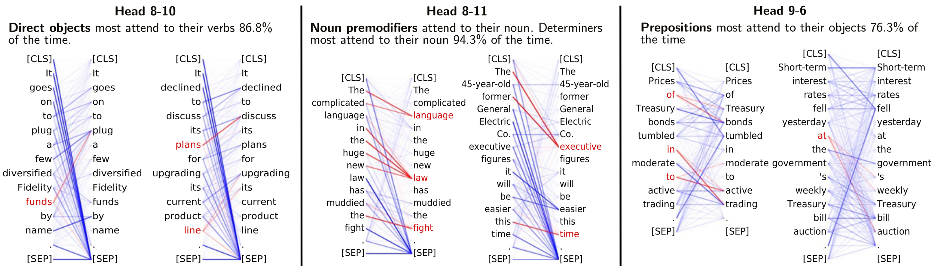
Probing for Universal Dependencies
Manning, C. D., Clark, K., Hewitt, J., Khandelwal, U., & Levy, O. (2020). Emergent linguistic structure in artificial neural networks trained by self-supervision. Proceedings of the National Academy of Sciences, 117(48), 30046-30054.

Slide 15
Probing with Minimal Pairs
Addition of such minor characters seem/seems more promotional than encyclopedic.
Other popular trade items of the area include/includes sandalwood, rubber, and teak.
The party that originally buys the securities effectively act/acts as a lender.
Manning, C. D., Clark, K., Hewitt, J., Khandelwal, U., & Levy, O. (2020). Emergent linguistic structure in artificial neural networks trained by self-supervision. Proceedings of the National Academy of Sciences, 117(48), 30046-30054.

Slide 16
Probing for the English Comparative Correlative

Slide 17
Comparative phrase
Sentences being compared, with long-distance filler-gap dependency and/or ellipsis
Fixed ‚the‘ at the start of each half
The funnier the example,
the more citations the paper will have.
If the example is funnier, the paper will have more citations
As the funniness of the example increases, so will the citations of the paper.

Slide 18
How can we probe if LMs understand this construction?
Split into two questions
Can PLMs learn the syntactic features of the construction?
Can PLMs learn the semantic features of the construction?

Slide 19
Syntactic Features: Probing Setup
Question: Can the model distinguish CC sentences from non-CC sentences?
Find minimal pairs of sentences that differ only in this one feature: do they include the CC?
Difficulty: finding very similar-looking sentences, that are still grammatically acceptable, and don‘t give any exploitable clues to the probing model

Slide 20
Minimal Pairs
First idea: Minimal Pairs from corpora
✅ She thinks the more water she drinks the better her skin looks .
❌ The way the older guys help out the younger guys is fantastic .
Easy vocabulary workarounds for the probing classifier, like occurrences of “the”
Complementary: Minimal Pairs generated by a CFG
✅ The flatter the fourteen lions push , the deeper and smaller the sixteen deer burn under the roof .
❌ The flatter fourteen push the lions, the deeper and smaller sixteen burn the deer under the roof.

Slide 21
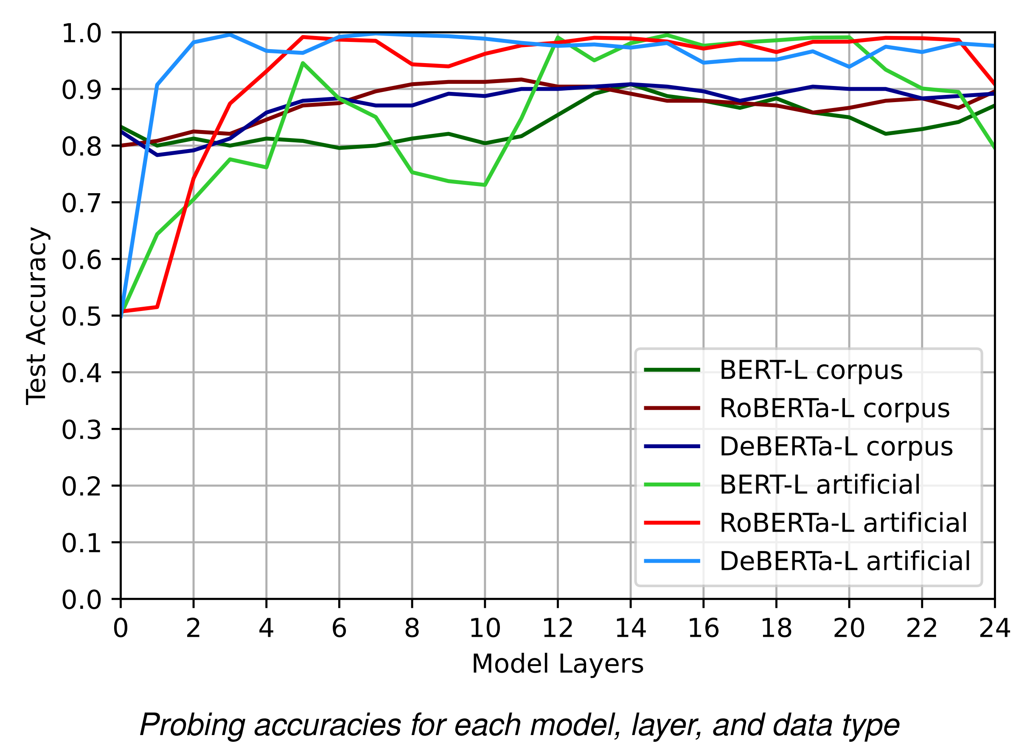
Syntax Probing Results
Models: BERT, RoBERTa, DeBERTa (all Large)
One-layer perceptron as probing classifier on top of every layer‘s contextual embeddings
Artificial sentences are at 50% acc on embedding layer, corpus sentences at 80%
90% or better accuracy for all models
The form of the CC seems to be recognised

Slide 22
Semantic Features: Probing Setup
Question: Can PLMs understand the meaning of the CC?
→ Can they use information given to them in a CC in a NLU task?
The stronger you are, the faster you are. Terry is stronger than John. Therefore, Terry will be [MASK] than John.
Can the model correctly predict faster?
Problem: the wrong answer shoud be included in the context
The stronger you are, the faster you are. The weaker you are, the slower you are. Terry is stronger than John. Therefore, Terry will be [MASK] than John. → compare p(faster) and p(weaker)

Slide 23
Bias
Bias: the model could always predict the adjective closest to the [MASK]. → recency bias
Test: swap first two sentences
S2: The weaker you are, the slower you are. The stronger you are, the faster you are. Terry is stronger than John. Therefore, Terry will be [MASK] than John.
Bias: the model could always predict the more frequent adjective. → vocabulary bias
Test: swap sentence halves so that the correct answer changes
S3: The stronger you are, the slower you are. The weaker you are, the faster you are. Terry is stronger than John. Therefore, Terry will be [MASK] than John.
Bias: the model could associate some names strongly with some adjectives → name bias
Test: swap names
S4: The weaker you are, the slower you are. The stronger you are, the faster you are. John is stronger than Terry. Therefore, John will be [MASK] than Terry.

Slide 24
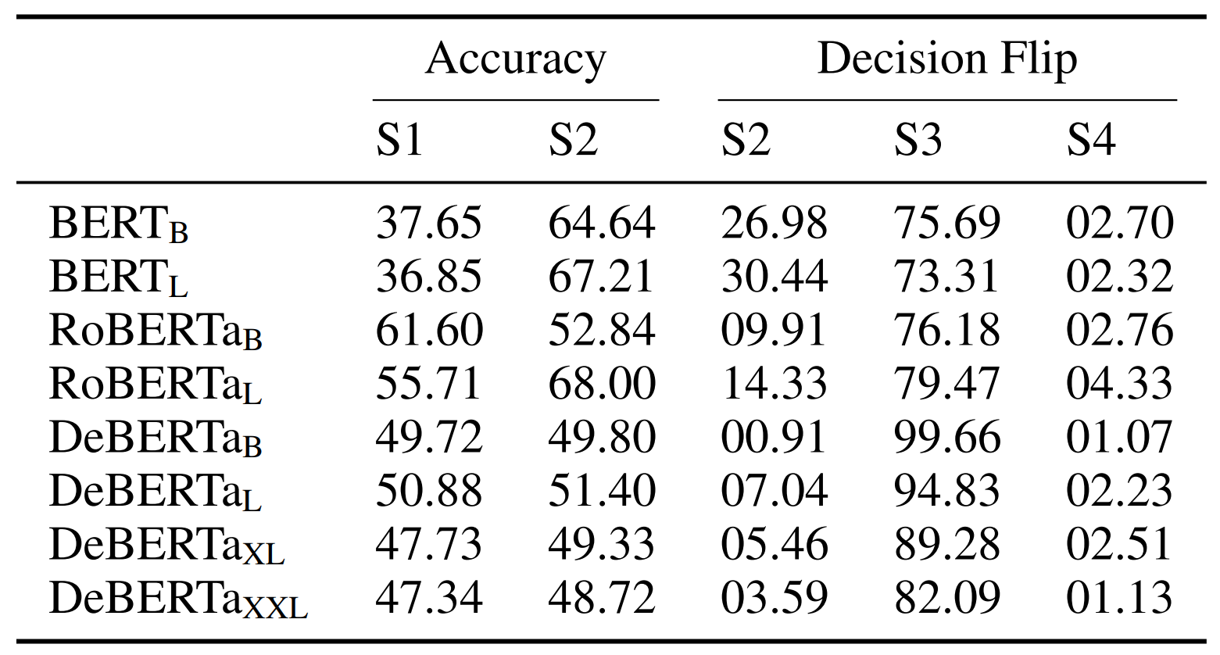
First Results
S2: test for recency bias
S3: test for vocabulary bias
S4: test for name bias
Accuracy is consistently better when the correct answer is closer to the MASK
Changing the correct answer by swapping sentence halves very strongly influences the answer
No recoverable significant performance from any of the models

Slide 25
One last chance: Calibration
Idea: if we can measure the ‚default‘ probabilities for each answer before we give the model any information, we can calibrate the actual answer by dividing by the default
C1: leave out CC sentence
Terry is stronger than John. Therefore, Terry will be [MASK] than John.
C2: add two unrelated names
→ The stronger you are, the faster you are. The weaker you are, the slower you are. Terry is stronger than John. Therefore, Eric will be [MASK] than Michael.
C3: add a third adjective
→ The weaker you are, the slower you are. The stronger you are, the faster you are. Terry is funnier than John. Therefore, Terry will be [MASK] than John.

Slide 26
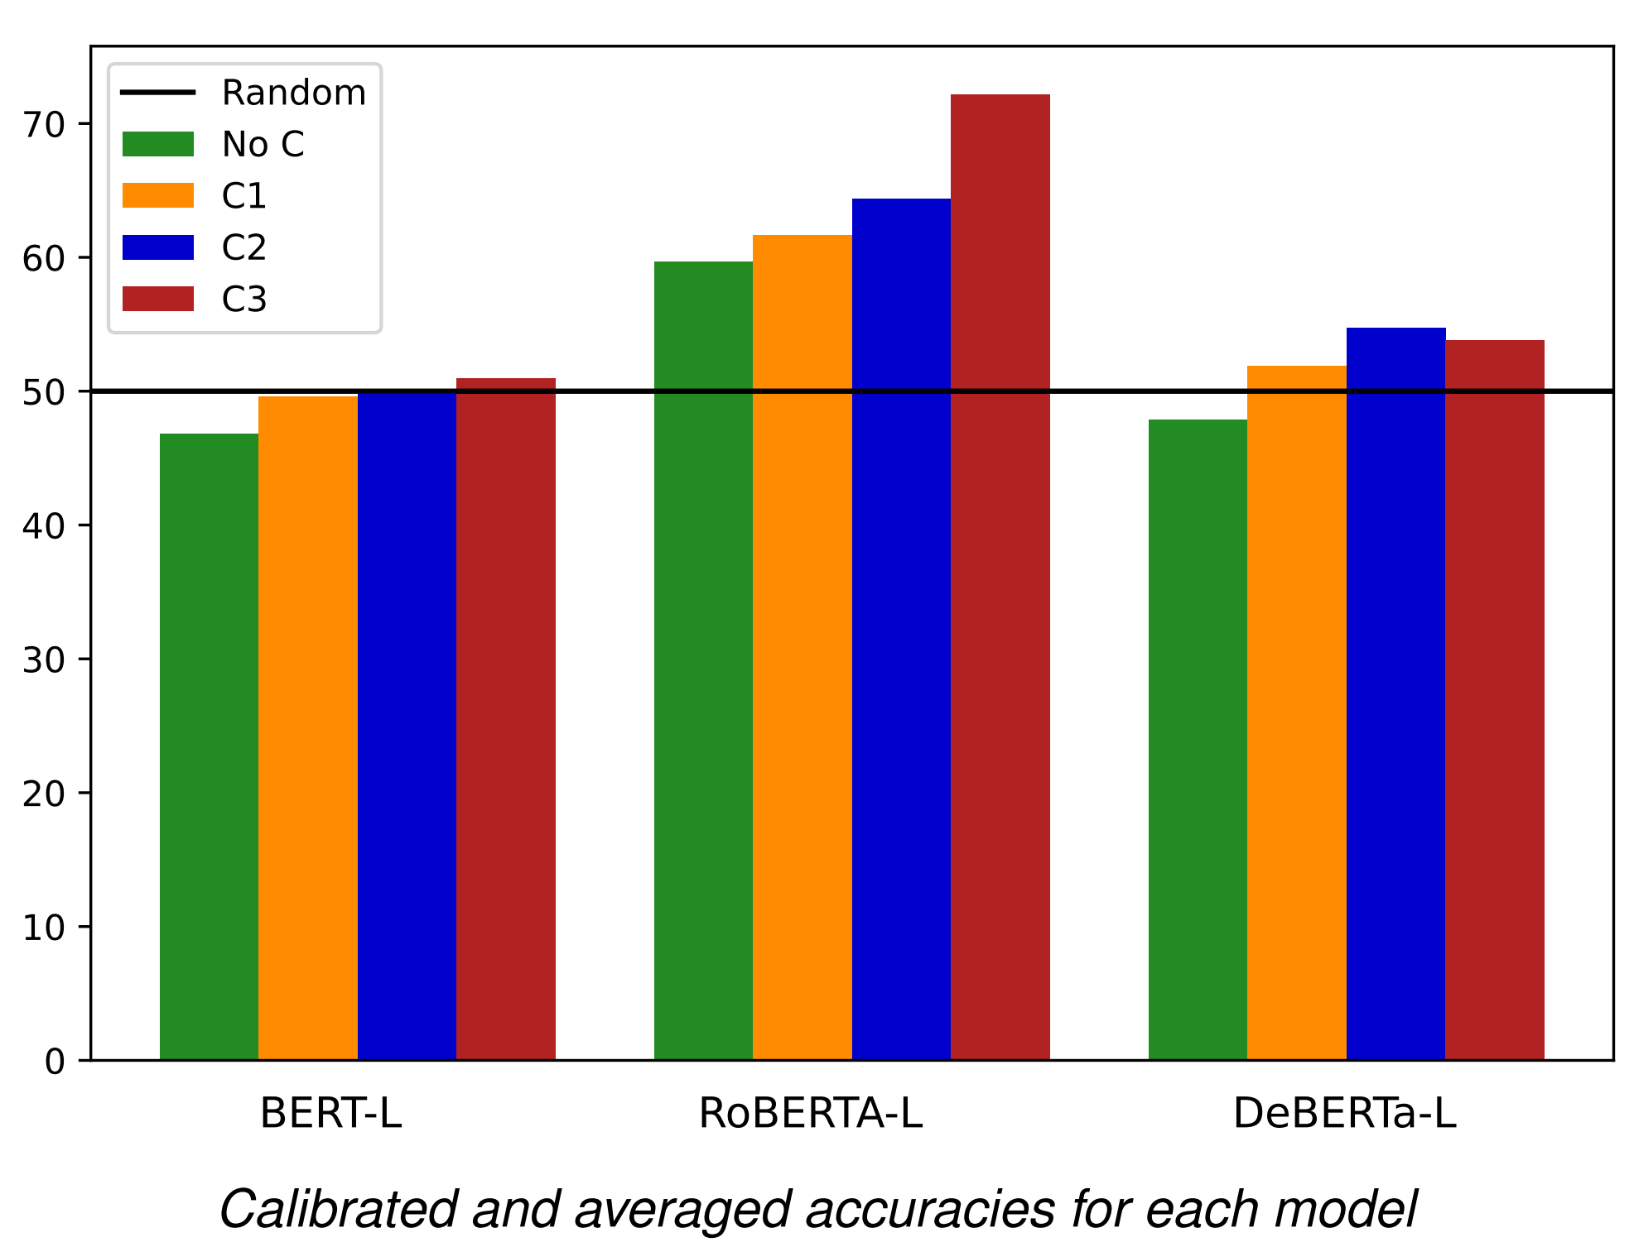
Calibrated Results
All calibration methods were somewhat helpful, especially for RoBERTa
BERT and DeBERTA perform at chance level
RoBERTa gets up to 70% accuracy
→ We can not conclude that PLMs understand the CC

Slide 27
English Comparative Correlative: Takeaways
We saw that…
The English Comparative Correlative is an interesting construction with many complex features
PLMs can reliably distinguish CC sentences from non-CC sentences
PLMS struggly to understand and use CC meaning in our setup

Slide 28
Probing for so-that sentences

Slide 29
Lexically Licensed (non-causal):
Lexically Licensed (causal):
Causal Excess (always causal):
I was so certain that I saw you
I was so happy that I was freed
I was so happy that I cried
causality
causality

Slide 30
Probing Idea
Similar to Comparative Correlative study: can models distinguish between instances of a construction and similar sentences
Crucial Differences
The similar sentences are also an interesting construction! (very rare)
Distinguishing between them is purely based on world knowledge and not on syntactic features
Examples are all from a corpus and that‘s ok: humans also use the adjectives to classify

Slide 31
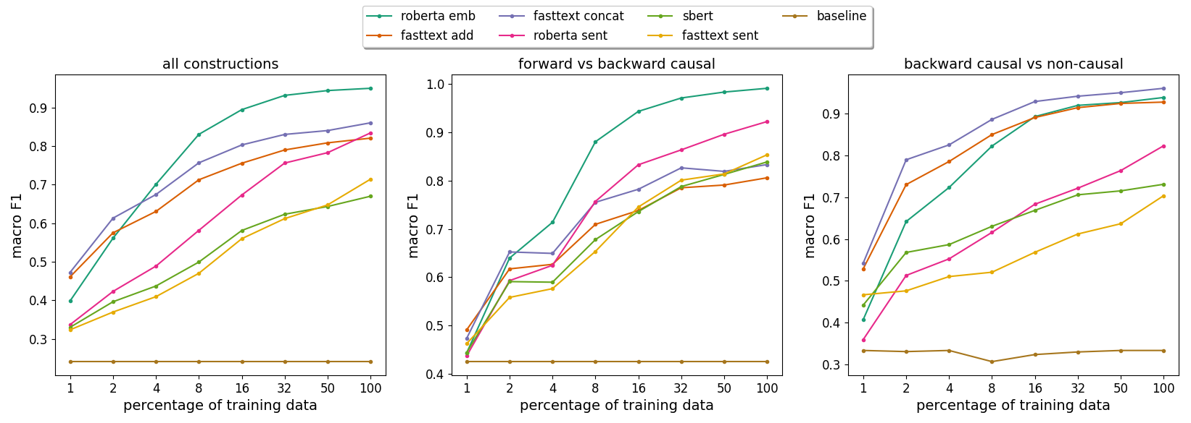
Results for So-That
F1 scores quickly rise above majority baseline
But: there are baselines using the „so“ and „that“ markers which achieve 97% accuracy

Slide 32
Additional Construction: Either-Or
Additional dataset: Either-Or, true or accidental usage
✅ Either the elephants were ferried across on rafts covered by dirt, or they swam 311 across.
❌No red flags have 313 emerged about either party in the inquiries 314 conducted formally or informally.

Slide 33
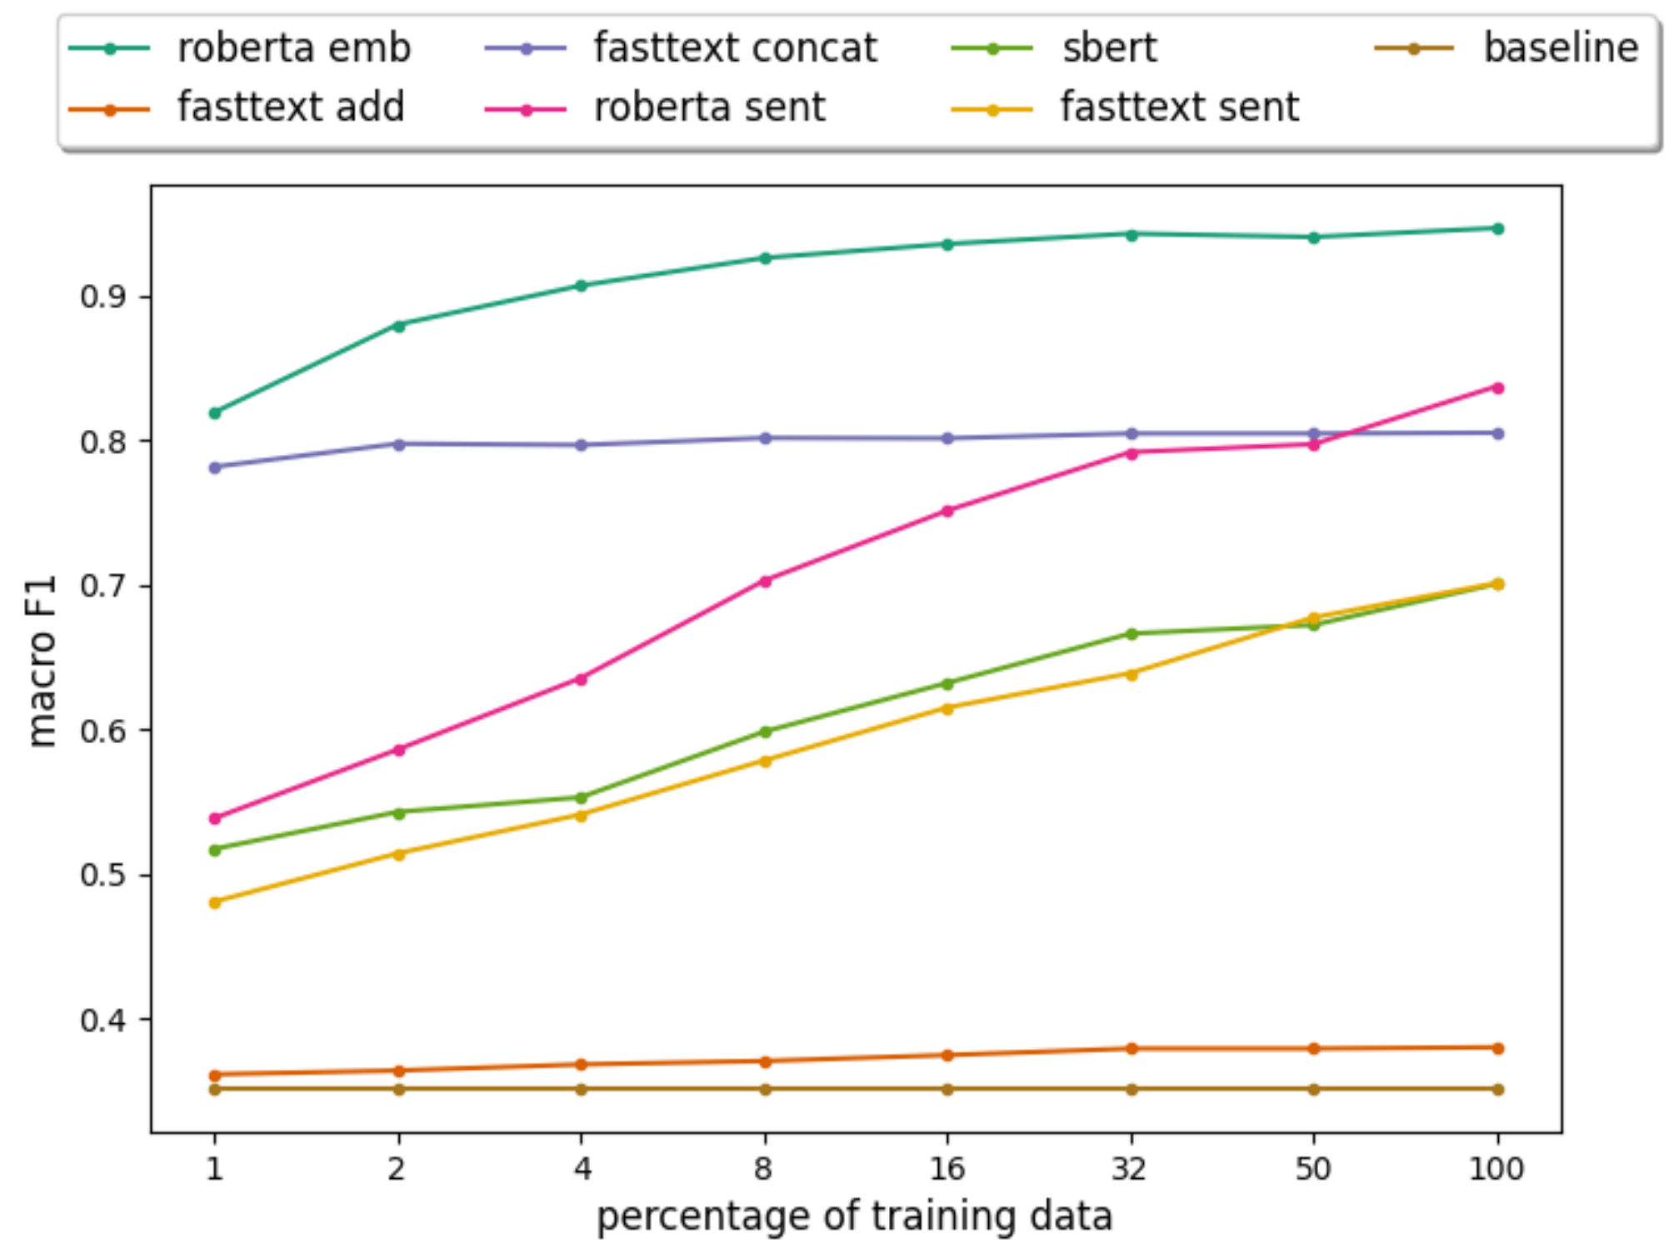
Results for Either-Or
Performance is fairly high fairly quickly
No easy way of using the presence of a word → summed up static embeddings perform at baseline level

Slide 34
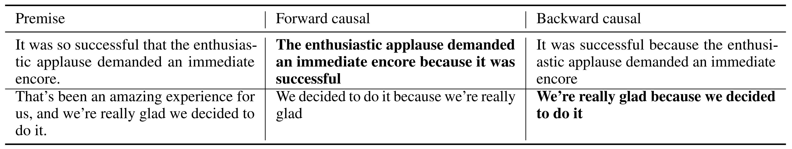
Usage-based Probing of GPT-3, BLOOM and OPT
Make the causal relationship explicit in both ways
Ask models which version is true and which is false, given the premise

Slide 35
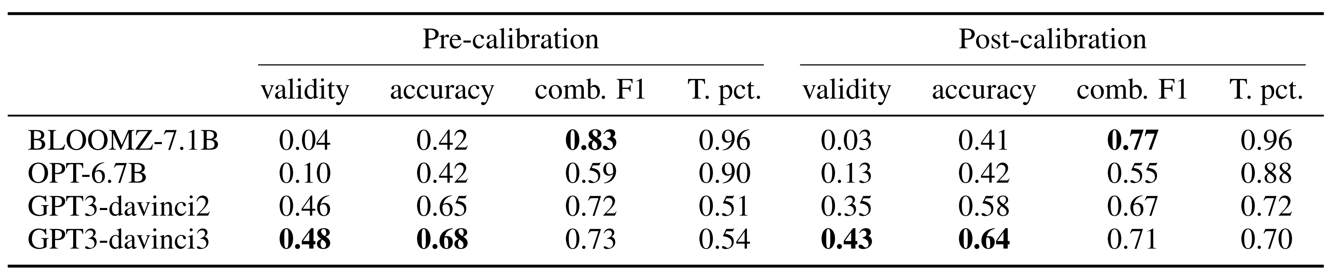
Results of Usage-based Probing
BLOOM and OPT answer True most of the time
GPT-3 models give balanced answers but are also not very accurate
Calibration hurts all performances

Slide 36
Takeaways
We have…
Collected two annotated corpora: one of so-that sentences and one of either-or sentences
Tested RoBERTa and fasttext embeddings using small probing classifiers for whether they can distinguish similar-looking constructions
Asked large prompt-based models questions about so-that sentences
Found that we can‘t conclusively say that the models can handle the constructions

Slide 37
Future Work: We need more data and more probing

Slide 38
What have we learned from our experimental work?
CxG-based probing requires manual focus on certain constructions (or groups), and specific experimental design
Test corpora had to be automatically collected and annotated by hand, or generated artificially
Overarching results are negative: it seems like constructions pose a problem for many language models

Slide 39
What do we want to do?
Develop methods that work with many constructions at once
Find lists of constructions (constructicons) that have been compiled by linguists and use them
Make more definitive statements about performance gaps in LMs

Slide 40
ToDos for Data
Exploiting non-CxG data: extracting constructional information from UD or similar?
Using Constructicons from Linguistics for probing
Annotating text for instances of constructions?
Ideally: unifying annotation schemata across constructicons and languages

Slide 41
Constructicons
Lists of constructions compiled by linguists
Languages currently covered: Brazilian Portuguese, Swedish, German, Japanese, English, Russian
Some are available online, but licences prohibit us from using them
Extent, detail, goals, and schemata vary wildly

Slide 42
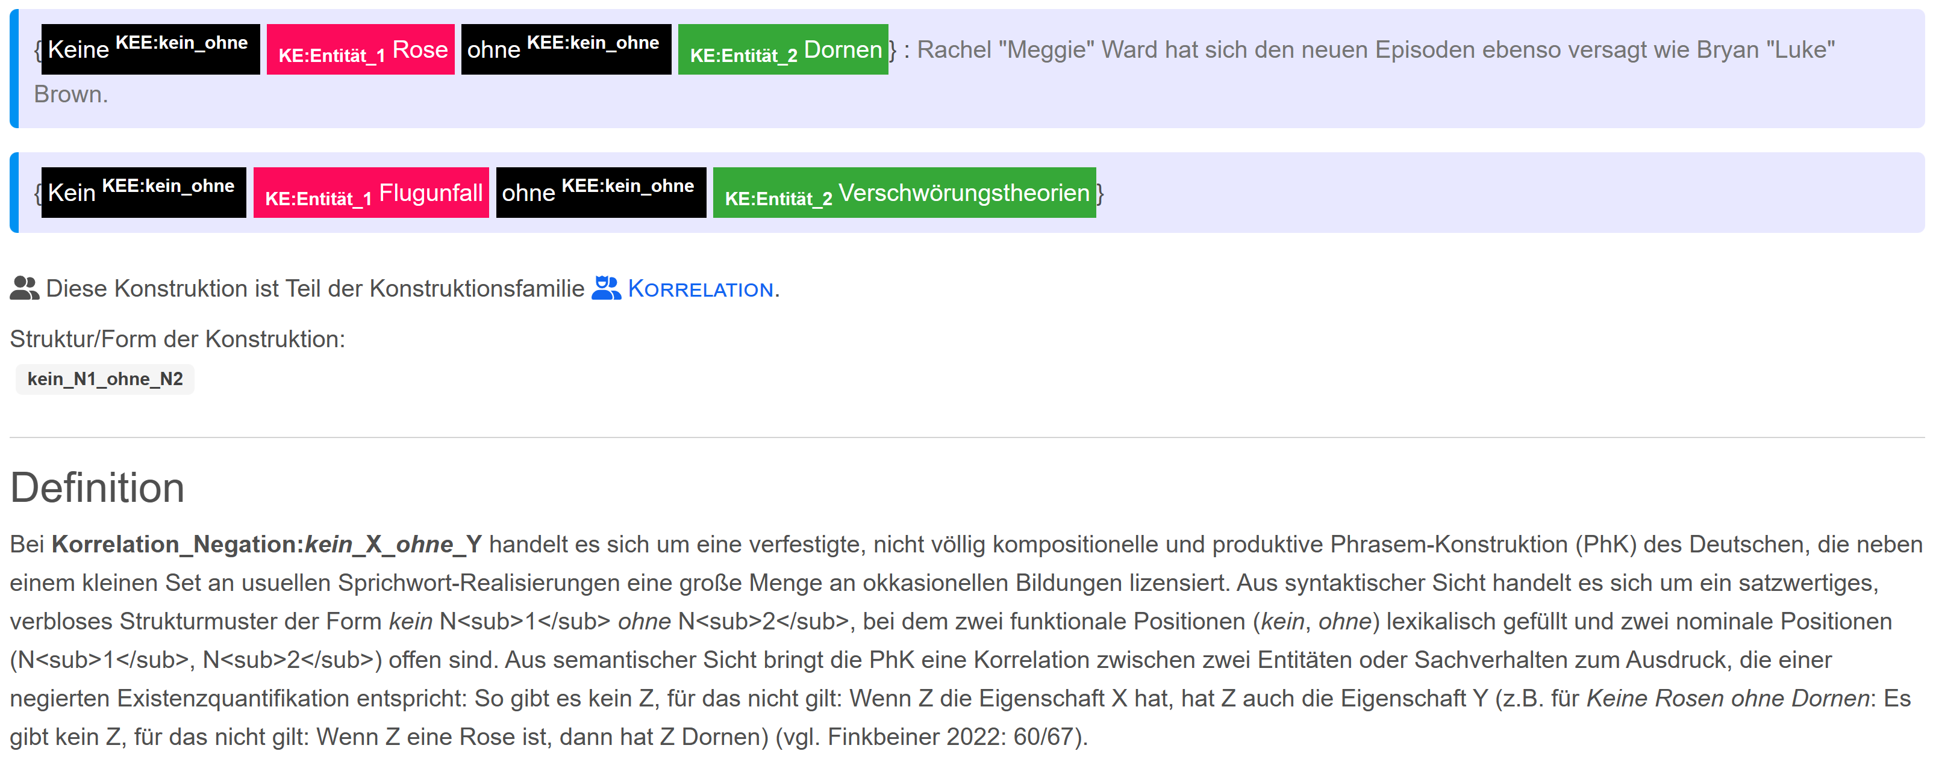
Constructicon Example: German

Slide 43
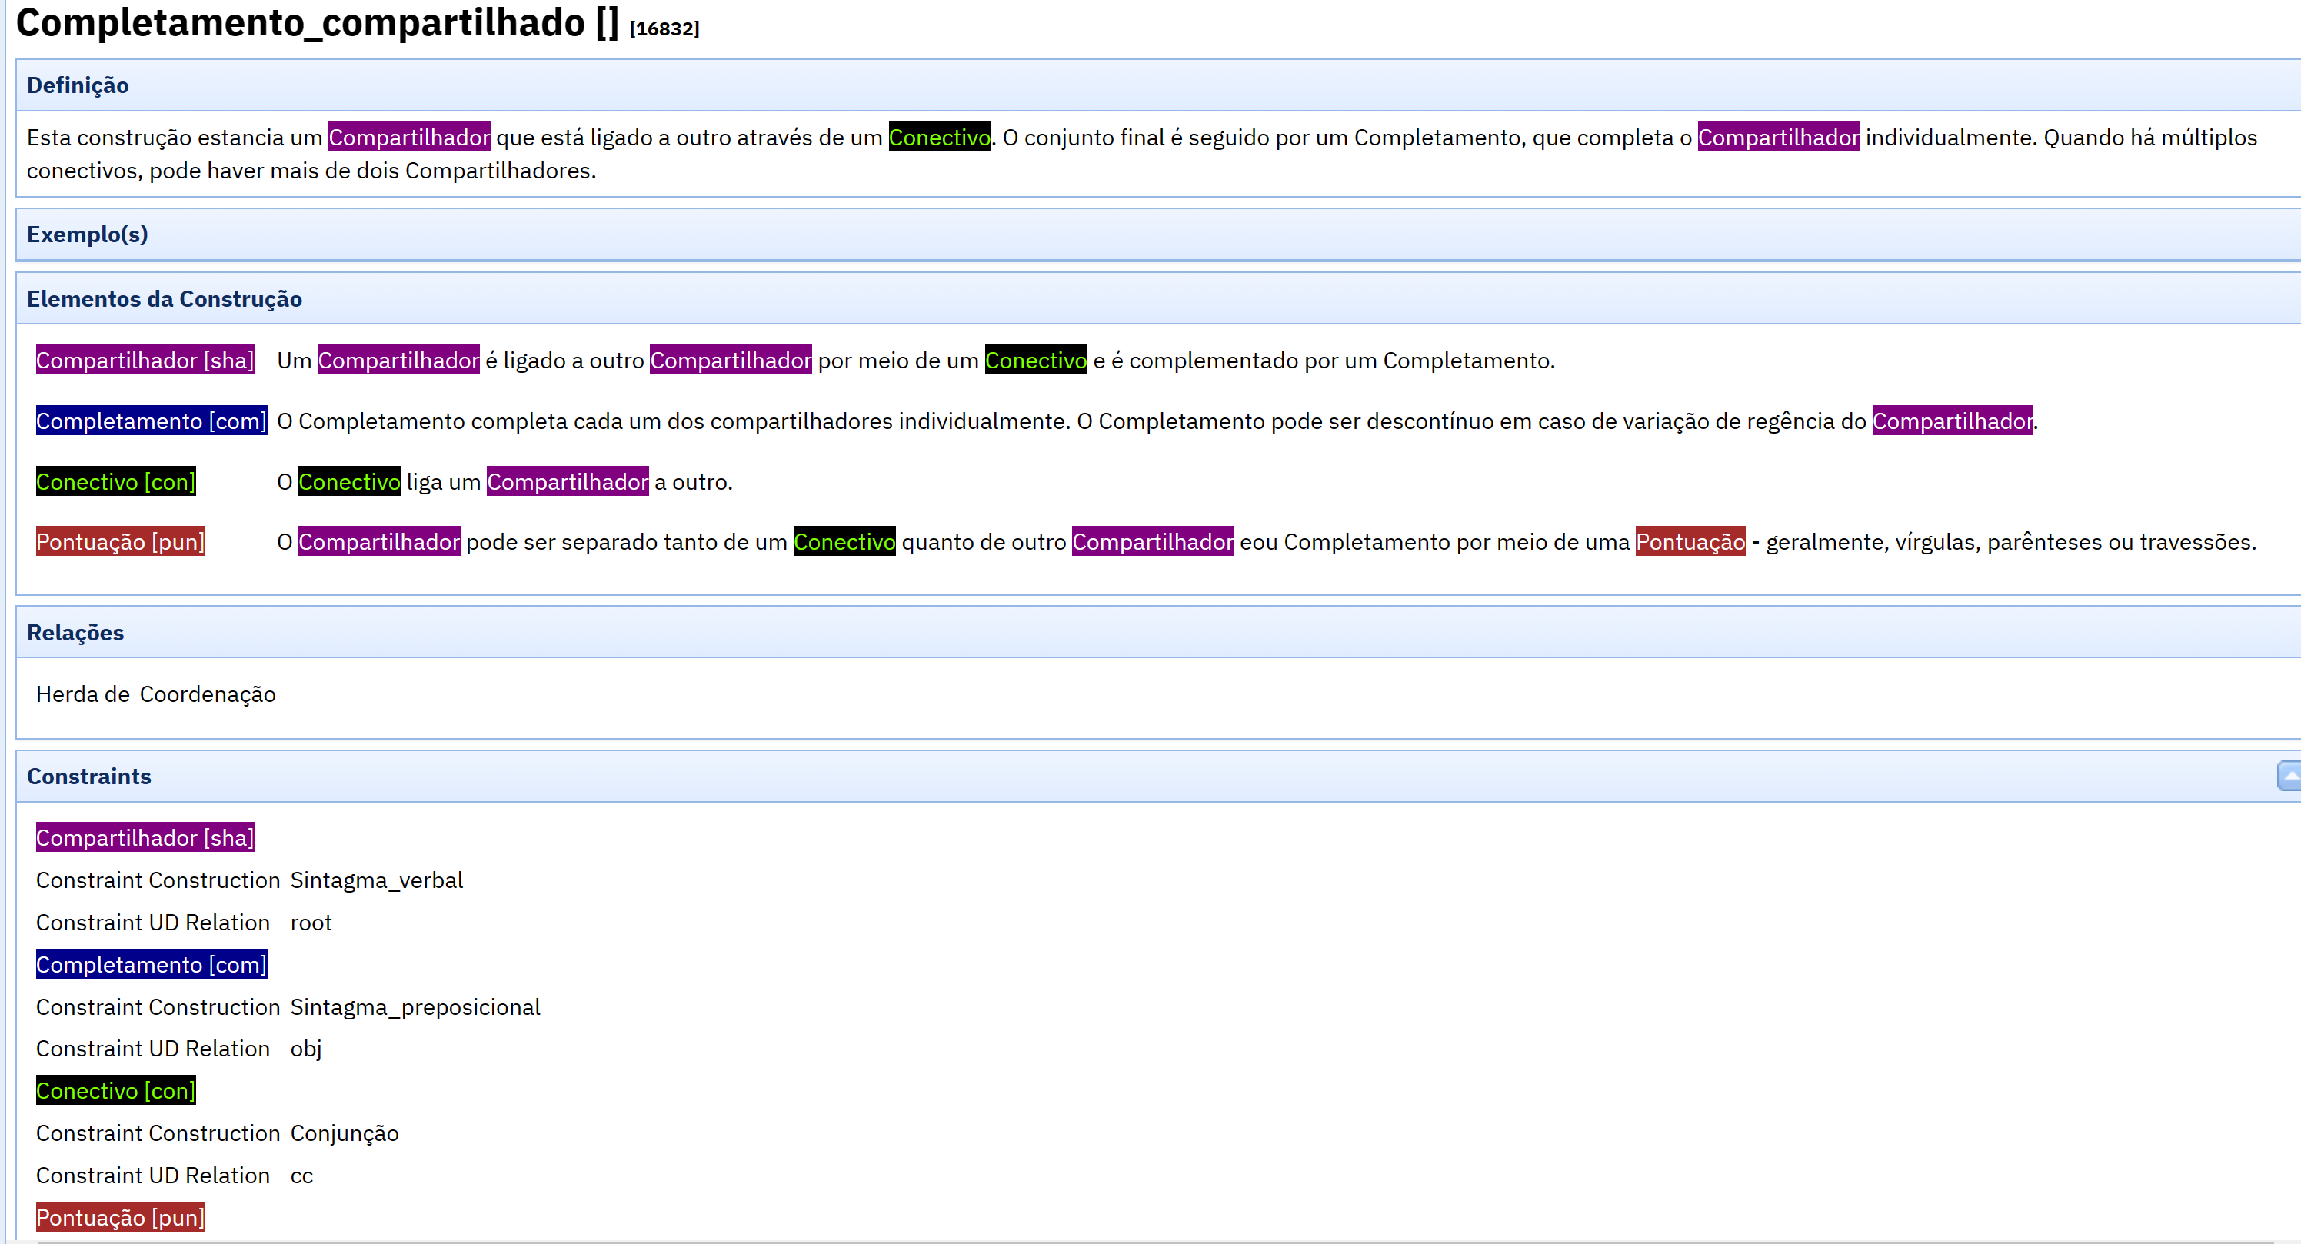
Constructicon Example: Brazilian Portuguese

Slide 44
Probing Methodology
Detailed probing methodology has focused on a few constructions at a time
Papers with more constructions have been more superficial in their methodology
The current paradigm requires detailed manual design
In contrast, UD probing was able to work with thousands of sentences
→ We need a new, more general probing methodology

Slide 45
Key Takeaways
Construction Grammar is a cognitively plausible theory of language that sees Syntax and Semantics as connected and proposes Constructions as the fundamental units of language
We can use Construction Grammar to ask interesting questions about the properties and capabilities of language models
There is much work to be done, especially in extending probing studies to a larger scale

Slide 46
Thank you for listening!
Check out our papers:
Leonie Weissweiler, Valentin Hofmann, Abdullatif Köksal, Hinrich Schütze (2022). The Better Your Syntax, the Better Your Semantics? Probing Pretrained Language Models for the English Comparative Correlative . Proceedings of the 2022 Conference on Empirical Methods in Natural Language Processing, pages 10859–10882, Abu Dhabi, United Arab Emirates. Association for Computational Linguistics. (EMNLP).
Leonie Weissweiler, Taiqi He, Naoki Otani, David R. Mortensen, Lori Levin, Hinrich Schütze (2023). Construction Grammar Provides Unique Insight into Neural Language Models . Proceedings of the Construction Grammars and NLP Workshop at the Georgetown University Round Table on Linguistics (GURT) 2023, Washington D.C., USA.

